Slide 1
Steel Surface defect detection

Slide 2
agenda
Problem definition
Motivation
Objective
Survey discussion
Tools used
Comments
What will we do next?
Preprocessing

Slide 3
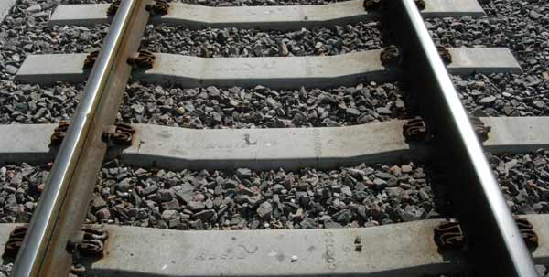
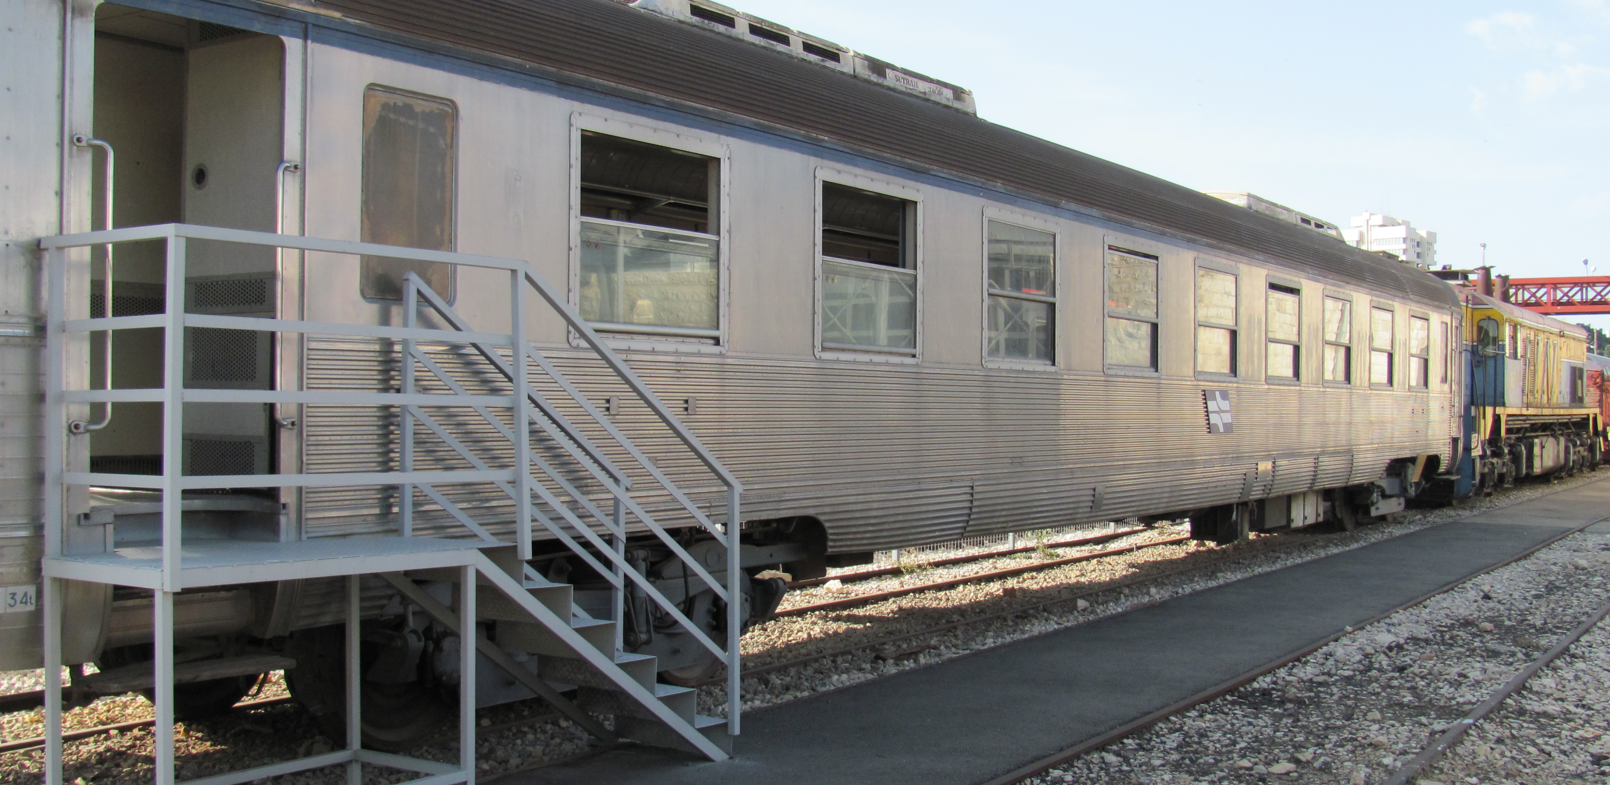
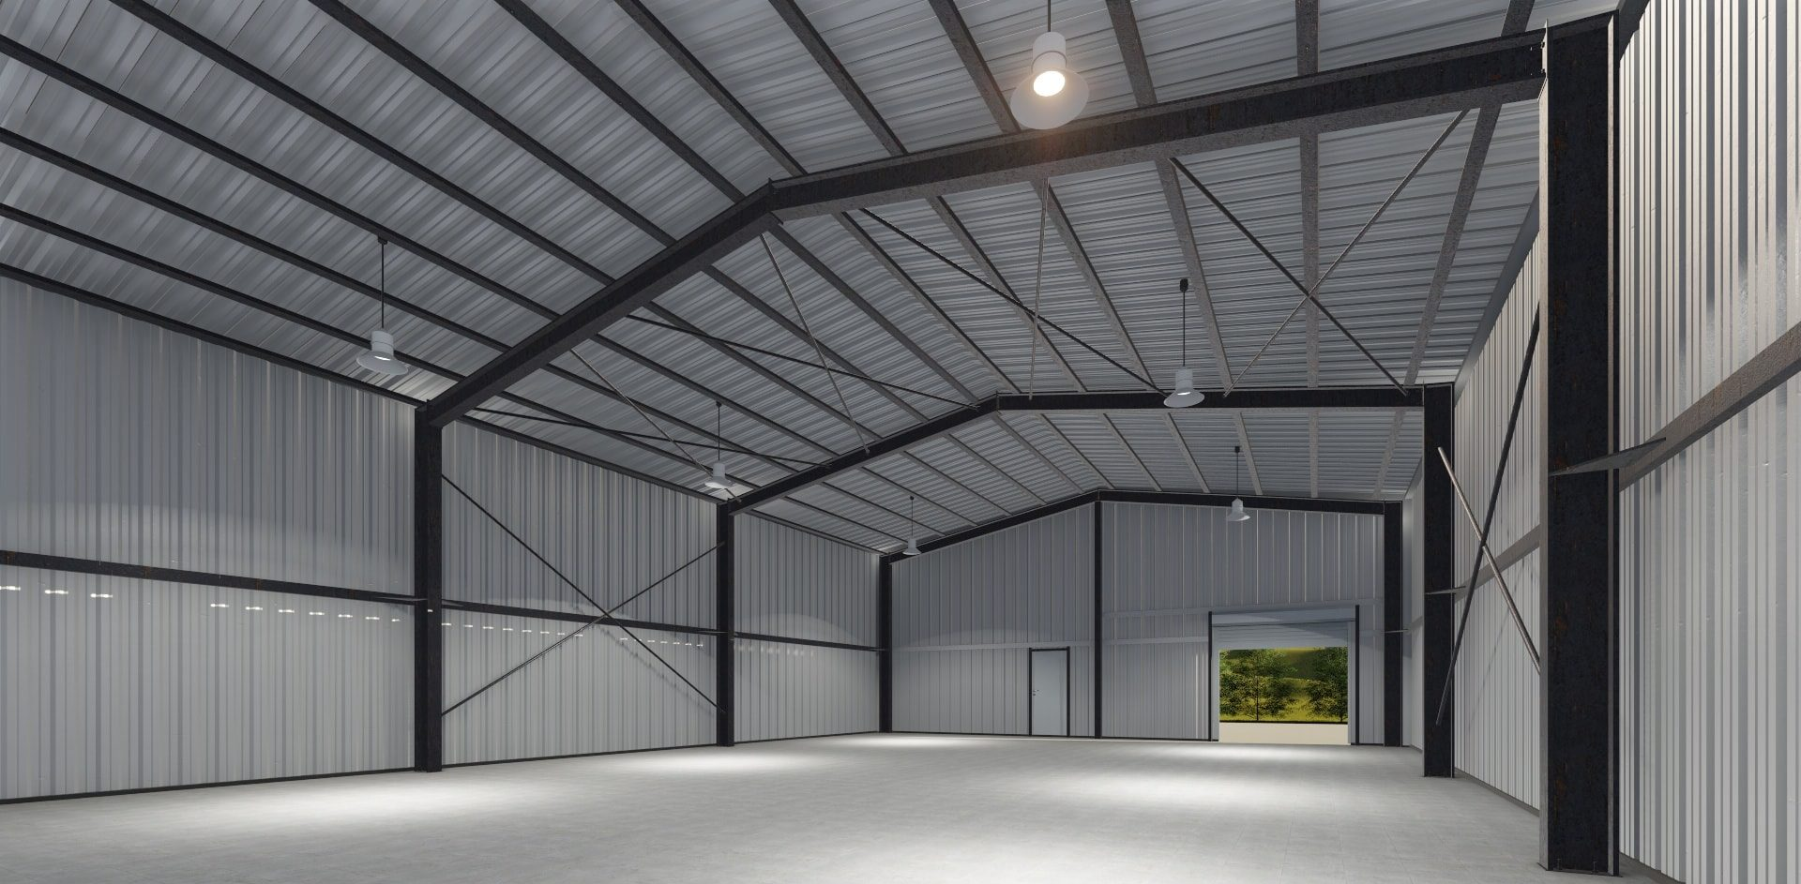
Problem definition
Steel is one of the most widely- used industrial metals and of metals which has helped very much in the development of industrial society

Slide 4
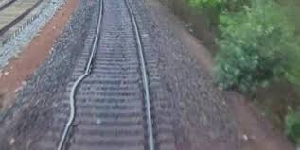
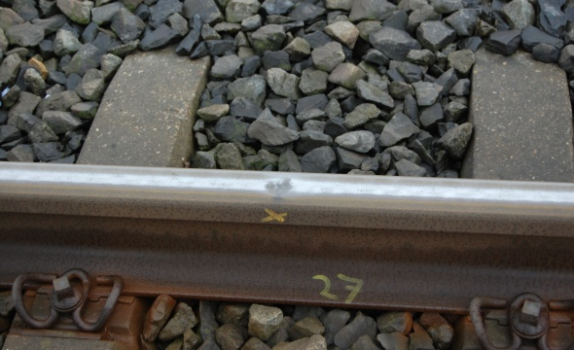
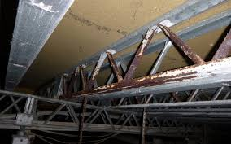
Problem definition
Steel has some Surface Defects Which will adversely affect bridges, roads, railways and buildings
Discovering these defects plays a significant role in quality enhancement in steel manufacturing, reducing costs of maintenance and protecting the lives of people

Slide 5
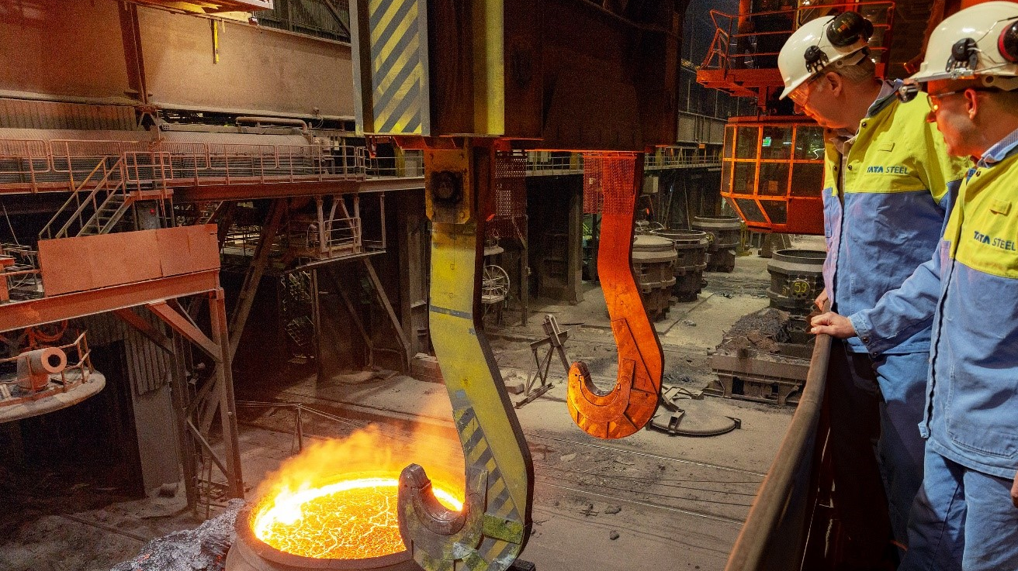
MOTIVATION
Why not just use the accuracy of visual inspection of people?
Harsh environment
Discovering defects with the naked eye is very difficult
Automation is much more faster

Slide 6
motivation
Why is it so important to discover defects?
The defects may cause significant economic losses and even safety accidents without effective defect detection.
Defects ruin important performances, such as the corrosion resistance, wear resistance, and fatigue strength. With defects, some steel is regarded as substandard or waste products in the further processing.

Slide 7
motivation
Why is automation much more efficient than manual inspection?
separating defective metal from normal metal in a very short period of time.
cost reduction

Slide 8
objective
Build an application to discover and classify Steel defects and their position using deep learning. Input will be steel images with different types of defects and output is the defect type and position.

Slide 9
Survey discussion
Paper Name | Dataset | # of Classes | Preprocessing | Feature Extraction and Classification | Accuracy | Comment
(IMP)Detection of Steel Surface Defect Based on Machine Learning Using Deep Auto-encoder Network April 11-13, 2017 | NEU | 6 Classes | Uses Histogram and Edge Detection. | Classifier : two classifier ANN DAN Feature Extractor : Histogram Technique. Edge Detection. | Using DAN the overall accuracy is 100%. | the same class of defects existing large differences in appearance. the defect images suffer from the influence of illumination and material changes.

Slide 10
tools
Paper Name | Dataset | # of Classes | Preprocessing | Feature Extraction and Classification | Accuracy | Comment
A New Ensemble Approach based on Deep Convolutional Neural Networks for Steel Surface Defect classification | NEU. | 6 Classes. | preserving transformation. | Deep Learning Model: DCNN. | accuracy: 99.889% . | Each DCNN is trained 5 times with different initial parameters individually. divided into three sets, training set, validation set and test set.
A deep-learning-based approach for fast and robust steel surface defects classification | NEU+ a diversityenhanced testing dataset of NEU. | unknown | Luminance, noise and blur removal. | Deep Learning Model: SqueezeNet-based model. | accuracy: 100% on NEU, 97.5% on Enhanced. | -Did not apply any data augmentation technique to increase the size of training data. -dataset will be publicly available.

Slide 11
Paper Name | Dataset | # of Classes | Preprocessing | Feature Extraction and Classification | Accuracy | Comment
SURFACE DEFECTS INSPECTION OF COLD ROLLED STRIPS BASED ON NEURAL NETWORK | unknown | Unknown. | median filter , Principal component analysis using singular value decomposition. | Deep learning Model: A feed-forward neural network. | accuracy: unknown. | -The back-propagation algorithm is used for training neural network, the performance index is mean squared error.
An End-to-end Steel Surface Defect Detection Approach via Fusing Multiple Hierarchical Features | NEU. |  | NO. | Feature Extractor: multilevel-feature fusion network . Classifier: CNN. | accuracy: 99.67% | -we attempt to establish an end-to-end defect detection system for ADI, which can provide a bounding box with a class score for precisely classifying and locating a defect .

Slide 12
Paper Name | Dataset | # of Classes | Preprocessing | Feature Extraction and Classification | Accuracy | Comment
Defect detection of hot rolled steels with a new object detection framework called classification priority network | hot rolled steel strips + hot rolled steel plates datasets. | 9 Classes. | gaussian blur, mean filtering and random dropout. | Deep Learning Model: classification priority network (CPN), multi-group convolutional neural network (MG-CNN). | accuracy: CPN (Classification rate, Detection rate)98.3% 96%. | - there is no explicit feature extraction in CNN. By optimizing the weights of the convolutional layers, all the feature descriptors are learned adaptively.
An Algorithm for Surface Defect Identiﬁcation of Steel Plates Based on Genetic Algorithm and Extreme Learning Machine | hot rolled steel plates. | 11 Classes. | NO. | Feature Extractor: Local Binary Pattern (LBP) operator. Classifier: ELM algorithm combined with a Genetic Algorithm . | accuracy: As average 96.38%. | -about 5% higher than those obtained by the ELM algorithm.

Slide 13
Paper Name | Dataset | # of Classes | Preprocessing | Feature Extraction and Classification | Accuracy | Comment
SteelSurfaceDefectDetectionUsingTextureSegmentationBasedonMultifractalDimension | unknown | 6 classes. | temporal Fourier analysis. | Feature Extractor: multifractal dimension. Classifier: | accuracy 97.9%.
Surface defect classification of steels with a new semi-supervised learning method |  |  |  | Feature Extractor: scale-invariant feature transform (SIFT) and support vector machine (SVM). Classifier: SGAN , convolutional neural network (CNN) . | accuracy 98%. | -the classification rates of these methods are relatively low and cannot meet industrial requirements.

Slide 14
Paper Name | Dataset | # of Classes | Preprocessing | Feature Extraction and Classification | Accuracy | Comment
A deep-learning-based approach for fast and robust steel surface defects classification | NEU. | unknown | No. | Feature Extraction: GLCM , AELTP , AECLBP. Classifier: SVM , NNC , MLR . | accuracy: 92.8% . | light-weight CNN model runs over 100 fps on a computer equipped with a single NVIDIA TITAN X Graphics Processing Unit (12G memory).
Steel Surface Defects Detection and Classification Using SIFT and Voting Strategy | unknown | unknown | No | Feature Extractor: SIFT. Classifier: SVM . | accuracy : 82.35%. | multiple outputs of a given input image with a specific defect type, we also propose a voting strategy for the final decision based on the one-versus-all multiple classifiers.

Slide 15
Paper Name | Dataset | # of Classes | Preprocessing | Feature Extraction and Classification | Accuracy | Comment
An End-to-end Steel Surface Defect Detection Approach via Fusing Multiple Hierarchical Features | NEU. | 6 Classes. | No.
This paper uses Deep convolution neural networks (CNN) | unknown | 6 Classes. | Flipping and Rotation. | Deep Learning Model: GoogLeNet and ResNet. | accuracy is 98.57%. | To reduce the overfitting it used data augmentation, Dropout and Batch Normalization.
This paper uses the CAE and Conventional Image Processing | NEU. | 6 Classes. | Anomaly detection method, Sharping, Gaussian Blur. | Deep Learning Model: CAE. | Unknown. | Challenges of this dataset are not only the changed of illumination and material, but also regarding similarity of inter-class and diversity of intra-class.

Slide 16
Paper Name | Dataset | # of Classes | Preprocessing | Feature Extraction and Classification | Accuracy | Comment
This paper uses the Slighter Faster R-CNN | unknown | 6 Classes. | sharpness augmentation and contrast augmentation. | Deep Learning Model: Faster R-CNN. | accuracy: 99% .
This paper uses An End-to-End Steel Strip Surface Defects Recognition System | uses their dataset and NEU . | 7 Classes. | resized images, Image Cropping, image rotation, adding noise and blur. | Deep Learning Model: DCNN. | accuracy: 99.05%
This paper uses Intelligent Real-time Vision System | unknown | 2 Classes. | noise removal. | Feature Extraction: rough filtering, and defect candidate finding. Classifier: SVM . | accuracy: 94.4%. | No online source for the dataset.

Slide 17
Paper Name | Dataset | # of Classes | Preprocessing | Feature Extraction and Classification | Accuracy | Comment
This paper uses Decision Trees Applied to LBP based Features | unknown | 6 Classes. | Sharping and rotation. | Feature Extraction: texture analysis method . Classifier: 1)decision tree classiﬁer . 2)Support Vector Machine. | -Accuracy for a two-class decision tree classiﬁer using PCA and Using Bagging was 97.18% and time was 0.4532s. -Accuracy for a multiclass Support Vector Machine using PCA and Using Bagging was 93.75% and time was 1.0608. | -if the dataset was very large to avoid underestimating the classification speed we can use PCA . - Another drawback associated with decision trees is their high variance we can use Bagging to reduce the variance.
This paper uses SIFT and voting strategy | unknown | 4 Classes. |  | Feature Extraction: SIFT. Classifier: SVM. | Average Accuracy: 90.32%. | Dataset is small and there is no augmentation for it.

Slide 18
Paper Name | Dataset | # of Classes | Preprocessing | Feature Extraction and Classification | Accuracy | Comment
This paper uses the CNNs to classify the surface defects of steel sheet | NEU | 8 Classes | 1) Rescaling 2) Rotation 3) Flipping | They used Deep learning to extract features . Model is a structure of 7 layers. Activation function is (LUs) . | -the average classification accuracy can be up to 99 % | small dataset
This paper uses the CNNs detect and Recognize | They Created their dataset | 3 classes | random rotation, translation zoom, shear, and elastic transformation | In classification modules, they used CNN network In detection module, they used (CASAE), | 89.60% | Large amount of repeated images as many transformations

Slide 19
Paper Name | Dataset | # of Classes | Preprocessing | Feature Extraction and Classification | Accuracy | Comment
Steel Defect Classification with Max-Pooling Convolutional Neural Networks | Not mentioned | 7 Classes | - resize the images to 150X150 - padding | They used Deep learning to extract features . The first architecture has 5 hidden layers, The second architecture has 7 hidden layers Activation function is PHOG . | The error rate is 7% clearly | Classes names are not mentioned

Slide 20
Paper Name | Dataset | # of Classes | Preprocessing | Feature Extraction and Classification | Accuracy | Comment
Steel Surface Defects Detection Based on Deep Learning | They used famous large datasets, such as PASCAL VOC, MS COCO, ILSCRV | 3 classes | random rotation, translation zoom, shear, and elastic transformation | In this paper, they used two deep learning models, 1-Faster RCNN(Regions with Convolutional Neural Networks) . 2-SSD(Single Shot MultiBox Detector). to detect defects on a hot-rolled steel surface. | Not mentioned Just, The experimental results also show that SSD is usually better than Faster RCNN | Num of images is limited in test and training (100). -Activation function and preprocessing step are not mentioned

Slide 21
Paper Name | Dataset | # of Classes | Preprocessing | Feature Extraction and Classification | Accuracy | Comment
Detection of Steel Surface Defect Based on Machine Learning Using Deep Autoencoder Network | NEU dataset | 6 classes | All images are processed by histogram and edge detection to extract features | -histogram and edge detection. -the Sobel edge detection algorithm *Two classifiers: -supervised feed-forward back propagation (BP) -Deep Auto-encoder | overall accuracy is 100%. | Small dataset
Detection of Steel Defect Using the Image Processing Algorithms | 250 steel defect images were used | 4 classes | ----------- | the common operations for defect detecting are: Thresholding, Noise removal, Edge detection and Segmentation. | Accuracy is 87% | Limited dataset Not classifier mentioned

Slide 22
Paper Name | Dataset | # of Classes | Preprocessing | Feature Extraction and Classification | Accuracy | Comment
Texture classification by statistical learning from morphological image processing: application to metallic surfaces | VAIMTSAS dataset | 3 classes | random rotation, translation zoom, shear, and elastic transformation | In this paper, they used Morphological image transformations and curvelets provide efficient descriptors for pixels Activation : PCA and LDA | The accuracy of 94.4% | database is not perfect. Indeed, pixels located near a defect border may not be easy to classify. Classes not mentioned

Slide 23
Datasets
NEU Dataset
Kaggle Dataset
6 Classes.
It’s Classes labeled(rolled-in scale (RS), patches (Pa), crazing (Cr), pitted surface (PS), inclusion (In) and scratches (Sc))
It’s size small.
The database includes 1,800 grayscale images: 300 samples each of six different kinds of typical surface defects.
4 Classes.
It’s Classes doesn't have label.
It’s size large.
The database includes 14,369 grayscale images(12,568 image for training and 1,801 for testing).

Slide 24
Comments On Survey
NEU is the most used dataset but its obstacle that it is small.
Most Papers uses deep learning in Classification.
Most Papers making Image Processing such as sharping because our defects need to strongly appear the edges of t steel in the image.
Number of classes from 3 to 8 .
Most Papers uses convolution neural network(CNN).
Most Papers making Data Augmentation to increase size of dataset.
Datasets for steel defects is limited and most of it doesn't clear.

Slide 25
What WE Will DO Next ?
Preprocessing Step:
Resize images to 224 x 224.
Applying Sharping For Images.

Slide 26
Tools
Python-PyCharm
Anaconda
Jupyter
spyder

Slide 27
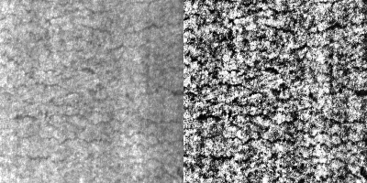
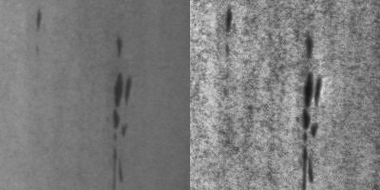
Adaptive Histogram Equalization

Slide 28
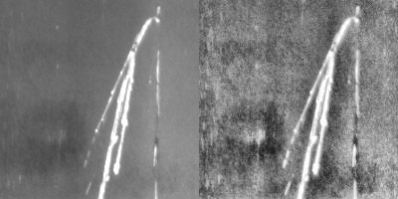
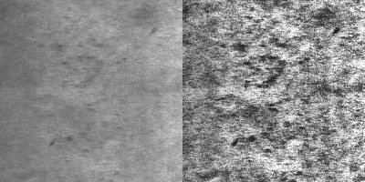
Adaptive Histogram Equalization

Slide 29
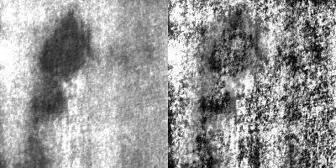
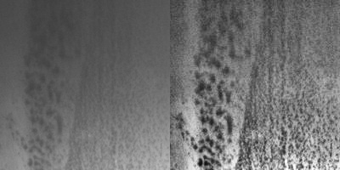
Adaptive Histogram Equalization

Slide 30
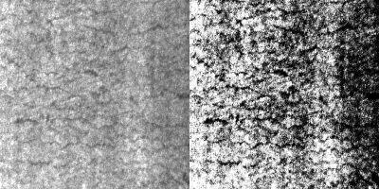
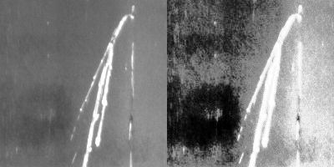
Histograms Equalization

Slide 31
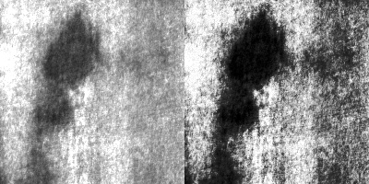
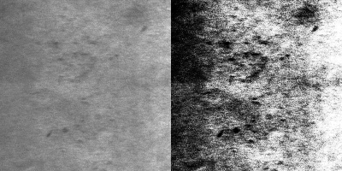
Histograms Equalization

Slide 32
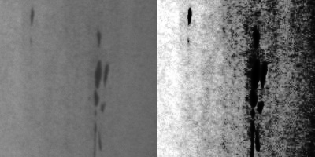
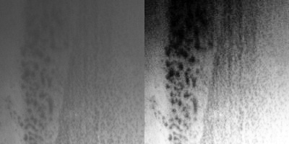
Histograms Equalization

Slide 33

Time Plan

Slide 34
References
https://www.kaggle.com/c/severstal-steel-defect-detection/overview
First A. Jiangyun Li∗ Second B. Zhenfeng Su∗ Third C. Jiahui Geng∗ Corresponding author. Yixin Yin∗∗ Real-time Detection of Steel Strip Surface Defects Based on Improved YOLO Detection Network IFAC PapersOnLine 51-21 (2018) 76–81
Xian Tao 1,* , Dapeng Zhang 1, Wenzhi Ma 2, Xilong Liu 1 and De Xu 1 Automatic Metallic Surface Defect Detection and Recognition with Convolutional Neural Networks Appl. Sci. 2018, 8, 1575
Elham Pishyar Mehran Emadi Investigation of Different Algorithms for Surface Defects of Steel Sheet for Quality International Journal of Computer Applications (0975 – 8887)Volume 149 – No.6, September 2016
D. Soukup and R. Huber-M¨ork Convolutional Neural Networks for Steel Surface Defect Detection from Photometric Stereo Images G. Bebis et al. (Eds.): ISVC 2014, Part I, LNCS 8887, pp. 668–677, 2014. Springer International Publishing Switzerland 2014
National University of Mongolia | NUM · Department of Computer and Information Technology Steel surface defects detection and classification using SIFT and voting strategy, International Journal of Software Engineering and Its Applications Vol. 6, No. 2, April, 2012
Sina Rezaei Aghdam and Ehsan Amid Mohammad Faghih Imani A Fast Method of Steel Surface Defect Detection Using Decision Trees Applied to LBP based Features, 2012 7th IEEE Conference on Industrial Electronics and Applications (ICIEA)

Slide 35
References Cont.
R. Gong, M. Chu, A. Wang, and Y. Yang, “A fast detection method for region of defect on strip steel surface,” Isij International, vol. 55, no. 1, pp. 207–212, 2015.
N. Wang and D.-Y. Yeung, “Learning a deep compact image representation for visual tracking,” in Advances in neural information processing systems, 2013, pp. 809– 817.
J. Redmon, S. Divvala, R. Girshick, and A. Farhadi, “You only look once: Uniﬁed, real-time object detection,” in Proceedings of the IEEE conference on computer vision and pattern recognition, 2016, pp. 779–788.
J. R. Uijlings, K. E. Van De Sande, T. Gevers, and A. W. Smeulders, “Selective search for object recognition,” International journal of computer vision, vol. 104, no. 2, pp. 154–171, 2013.
J. Long, E. Shelhamer, and T. Darrell, “Fully convolutional networks for semantic segmentation,” in Proceedings of the IEEE conference on computer vision and pattern recognition, 2015, pp. 3431–3440.
http://faculty.neu.edu.cn/yunhyan/NEU_surface_defect_database.html

Slide 36


